Slide 1
Sawyer Mobile Device Interaction
Aharon Sebton, BS/MS EE

Slide 2
Problem Statement
What
Enable collaborative robots with touch device accessibility
Why
Automated testing of mobile devices or applications
When paired with gaze and fixation data processing, could enable people with muscular dystrophy or arthritis to interact with mobile devices through the robot
Scope of this Project
Enable Sawyer to perform single and multi-touch gestures on a stationary touch-enabled device

Slide 3
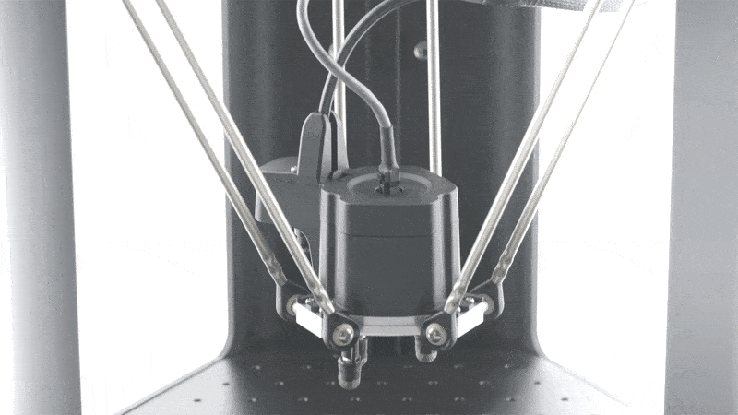
Proposed Solution
Attach stylus pen tips to Sawyer’s electric parallel gripper in a nonpermanent manner
Analyze Sawyer’s force sensor data to apply appropriate amount of pressure to the screen
Use joint-space trajectory planning to move end effector linearly across the screen
Develop Python scripts for tapping, swiping, and pinching

Slide 4
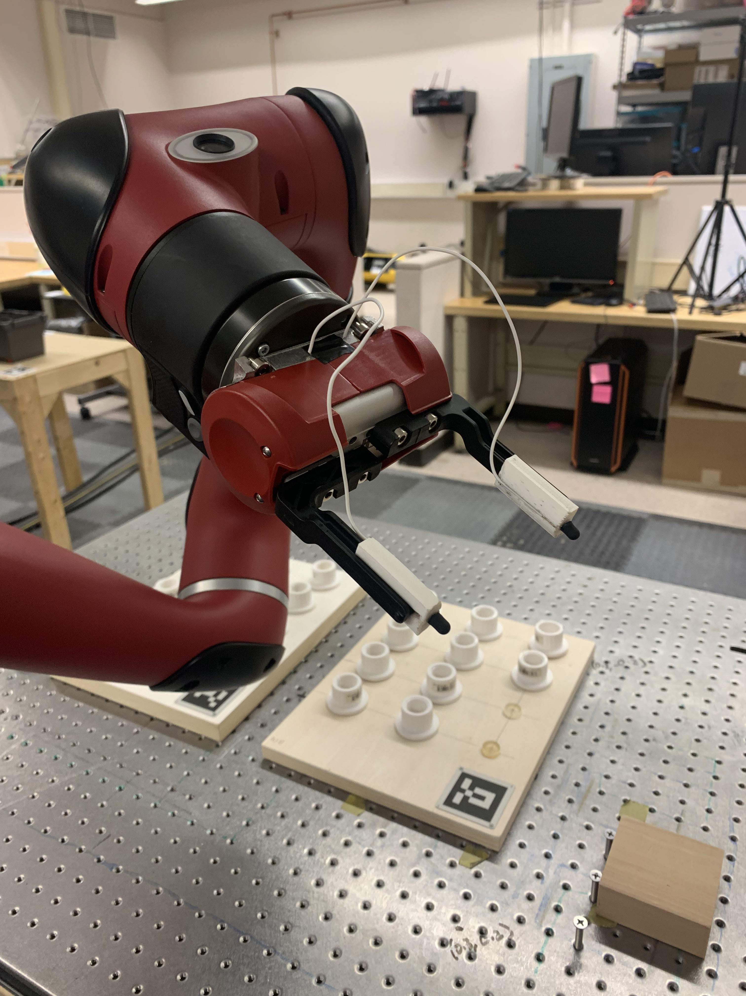
Implementation - Hardware
Ordered stylus pen tips
Capacitive- absorbs screen’s electrostatic field
Tool tips 3D printed to slide on gripper and
hold stylus
Later added grooves to hold wires
Used band saw to adjust groove width and depth
Wires
Stripped on each end, wrapped around front of
tool tips, glued into tool tip grooves, electrical
taped to conductive part of robot
Stylus pen tips glued to tool tips
Ensuring contact with wires

Slide 5
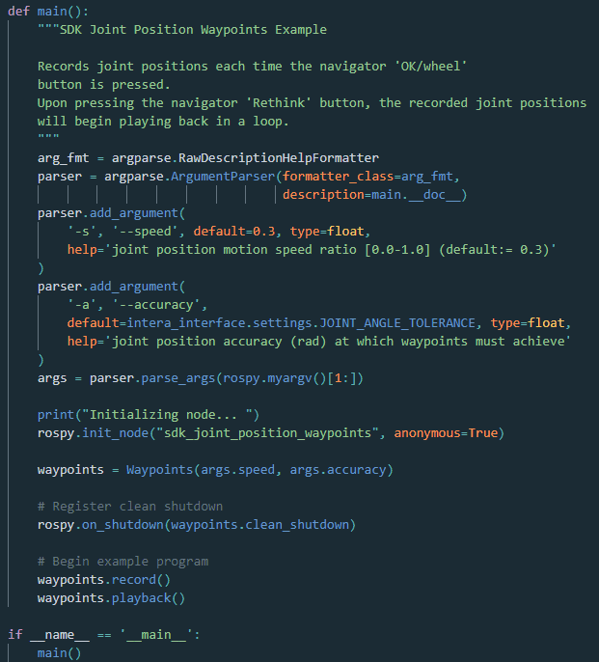
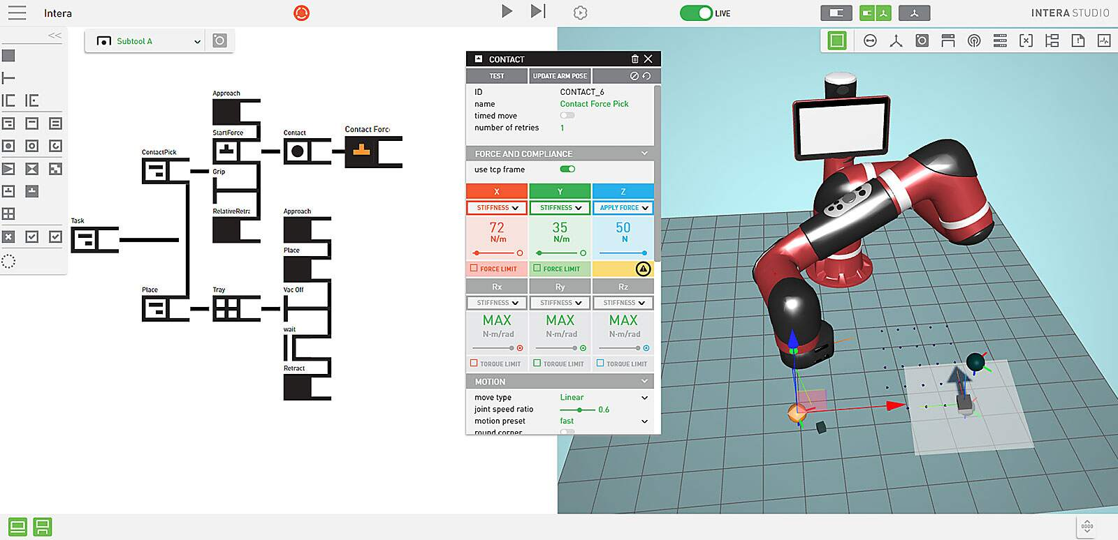
Implementation - Software
CAD model of tool tips
Designed in Autodesk Fusion 360
Second iteration included wire grooves
Python scripts for touch gestures
Used intera_interface API
Sawyer SDK Wiki examples
Intera software

Slide 6
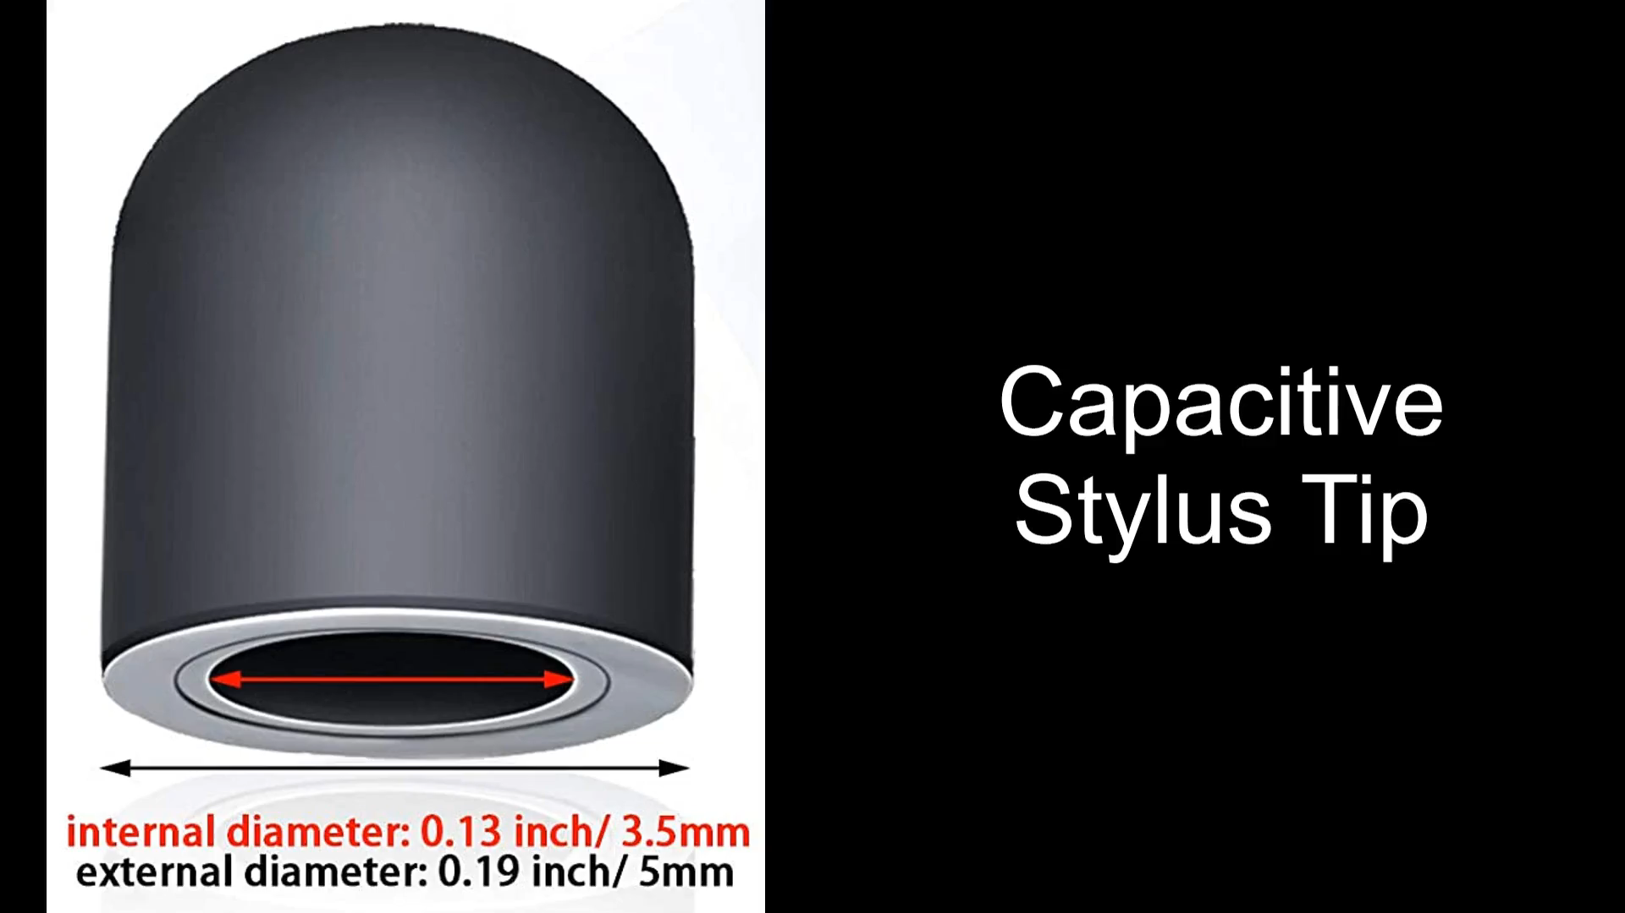
Results
Successful but crude tap, swipe, and pinch gestures
Able to check endpoint force applied periodically, but unable to use ISR in Python scripts
Future Work
Repeatability testing
Add computer vision
Process biological signals, dictate robot’s actions

Slide 7
Questions

